Slide 1
Color Assimilation
Xinrun Zhang
09/26/2018

Slide 2
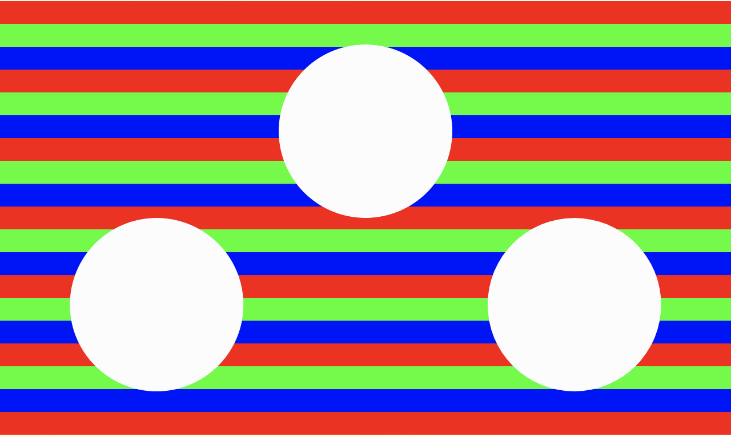
What to see

Slide 3

What to see

Slide 4

What to see

Slide 5

What to see

Slide 6

What to see

Slide 7

What to see

Slide 8
Comparison

Slide 9
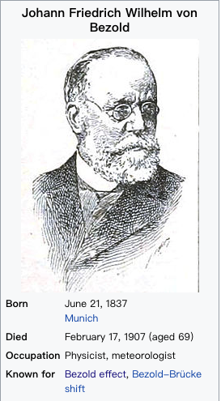
Who find this phenomenon?

Slide 10
Reasons
Color assimilation occurs when two color patches are perceptually grouped, and their apparent color difference is reduced.

Slide 11
Reference
https://en.wikipedia.org/wiki/Wilhelm_von_Bezold
http://www.michaelbach.de/ot/col-assim/index.html

Slide 12
Thank You

